Slide 1
Deceptive Reinforcement Learning
Integrating Multiple Rewards using Q-Tables
Supervisor: Prof. Tim Miller
Group Members:
Yingnan Shi 1025903,
Junchao Wang 1032268,
Qingfeng Xu 967175
Notes:
Hello, this is qingfeng xu, and here are my teammates. Our research project topic is deceptive reinforcement learning- integrating multiple rewards using Q-tables. Our supervisor is Tim Miller.

Slide 2
Content
Background
Project Introduction
Methods
Evaluation
Conclusion
Notes:
Here are the content that we will talk about in our presentation. Firstly, we will introduce the background knowledge about our project, including what is reinforcement learning and what is deceptive reinforcement learning. Secondly, we will introduce our project, integrating multiple rewards in single Q-table. After that, we will discuss two solutions, the one is rewarding shaping, another is entropy method. Then, we will show the evaluation results by comparing with baseline and previews work. At last, there will be a brief conclusion.

Slide 3
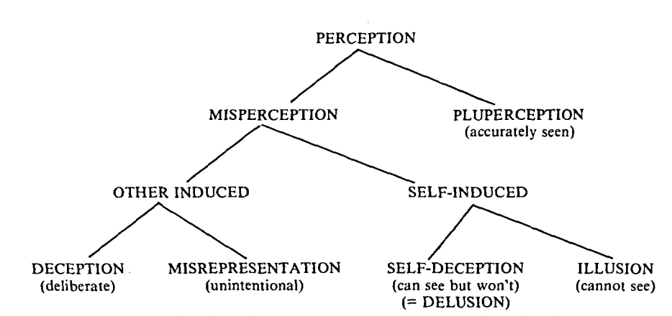
What is deception?
Picture Source: Whaley, B. (1982). Toward a general theory of deception. The Journal of Strategic Studies, 5(1), 178-192.
Background
Notes:
At first, let’s come to what is deception. In 1982, Whaley proposed that deception is a kind of perception. The important points is that it is a other induced misperception with true representation.
A deceiver intending and attempting to induce deception, contrives and projects a false picture of reality(Whaley, 1982).

Slide 4
Why deception?
Path A
Path B
Background
Notes:
Deception, can be a useful tool in national Defense, games, cybersecurity and etc. For example, there are several potential targets and our army is going to attack one of those. The enemy is able to observer our army by satellite and we want them to realize what is exactly the real goal of us until the last moment. How can we plan the path? The red point is the real target, while we try to mislead the enemy, therefore, we choose a deceptive path B since the enemy may think our goal is blue point.

Slide 5
Deception Methods (Whaley, 1982)
Deception
Dissimulation
(Hiding the real)
Simulation
(Showing the false)
Background
Notes:
There are two kinds of deception methods, we focus on dissimulation, which means we only hide part of real information to deceive others, rather than showing the false result to them.

Slide 6

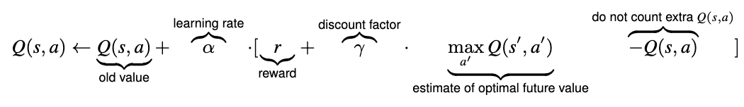
What is Reinforcement Learning?
Background
Notes:
Then, let’s come to Reinforcement learning (RL) is an area of machine learning concerned with how software agents ought to take actions in an environment in order to maximize the notion of cumulative reward.
The typical framing of a Reinforcement Learning (RL) scenario: an agent takes actions in an environment, which is interpreted into a reward and a representation of the state, which are feed back into the agent.
An important part of the reinforcement learning framework is the reward function, which determines when and how much reward (negative or positive) is given for each possible behaviour in a system.

Slide 7
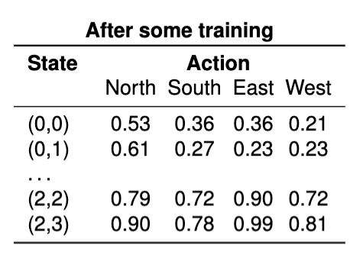
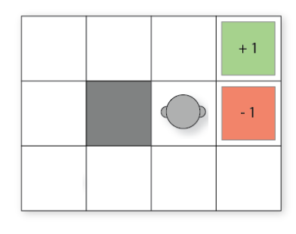
Q-Learning
Picture Source: Unimelb Comp90049 lecture slides,
2019, By Timothy Miller
Background
Notes:
One of important concept in reinforcement learning is Q-learning. In Q-learning, we generate a Q-table, and find the path according to the Q-table. Q-Table is just a fancy name for a simple lookup table where we calculate the maximum expected future rewards for action at each state. Basically, this table will guide us to the best action at each state.

Slide 8
Why Reinforcement Learning?
Model-based Method
Last deceptive point (LDP) (Masters and Sardina, 2017)
A formula to calculate an optimal LDP
Require reasoning about the model structure
Background
Notes:
The key probelm is that why we use reinforcement learning for deception path planning. There are two types of method in deception path planning, the on is model-based method
Usually this kind of method require a way to calculate an optimal last deceptive point. The last deceptive point means :given a path , its last deceptive point LDP is a node π , which is itself deceptive whereas all (if any) subsequent nodes are truthful. For example,

Slide 9
Last Deceptive Point Example
Path B
Background
Notes:
The yellow point is the last deceptive point, since all the points after this point are true to the real goal. While before the yellow point, the observer may think that path B may aim to blue point rather than the real goal

Slide 10
Why Reinforcement Learning?
Model-based Method
Last deceptive point (LDP) (Masters and Sardina, 2017)
A formula to calculate an optimal LDP
Require reasoning about the model structure
Model-free method-RL
Only rely on real samples from the environment
Example: Ambiguity Model (Yue, Zhengshang, Peta, Tim M)
maximise the entropy from the observer’s point of view
Problem: Require mutiple Q-Tables when dealing with multiple rewards
Background
Notes:
However, this method Require reasoning about the model structure to inform the dissimulation!
the other method is model free based
They rely on real samples from the environment and never use generated predictions of next state and next reward to alter behaviour (although they might sample from experience memory, which is close to being a model).
For example, the ambiguity model is proposed which generate deceptive path by maximising the entropy from the observer’s point of view. It doesn’t require a model structure, but it Require mutiple Q-Tables when dealing with multiple rewards
Our work focus on model-free method, therefore we use reinforcement learning method to design deceptive path.
In the next part, junchao will introduce the project details

Slide 11
Our Directions and Models
Our models
Heuristic Model
Entropy Model
One q-table for multiple reward functions
Original model
Ambiguity model
Mutiple q-table for multiple reward functions
V.S
But why?
Project Introduction

Slide 12
Our Directions and Models
Our models
Heuristic Model
Entropy Model
One q-table for multiple reward functions
Original model
Ambiguity model
Mutiple q-table for multiple reward functions
V.S
But why?
1. Less time complexity. Especially when there are many possible goals(bogus goals).
2. Less information thus lower possibility of leakage
Project Introduction

Slide 13
Model 1: Heuristic Model
“Designing a reward structure that leads an AI away from the optimal policy can be seen as a form of deception… ”
“If we see the reward function as a heuristic function approximating the (inverse) distance from a globally optimal policy, a deceptive reward function is an inadmissible heuristic.”
—Anderson, et al, 2018
Example: Super Mario
Methods

Slide 14
Model 1: Heuristic Model
Problem:
How to make sure to reach to our destination, not just being irrational?
Answer:
By reward shaping!
The key idea: add additional reward for particular behaviors.
Methods

Slide 15
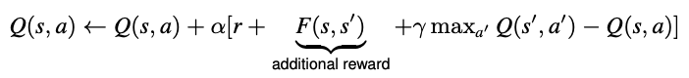
Model 1: Heuristic Model
Our Reward shaping: Add the sum of distances to all fake goals, and then gives it a weight.
As close as possible to all fake goals to be deceptive
Eventually Reach the goal
Methods

Slide 16
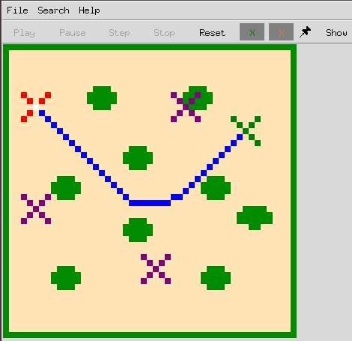
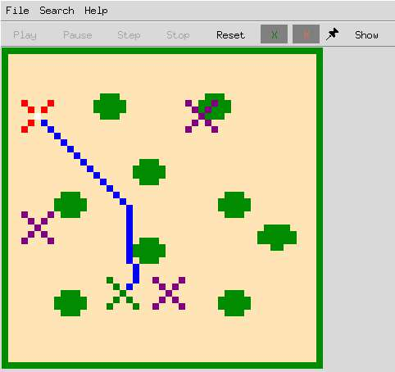
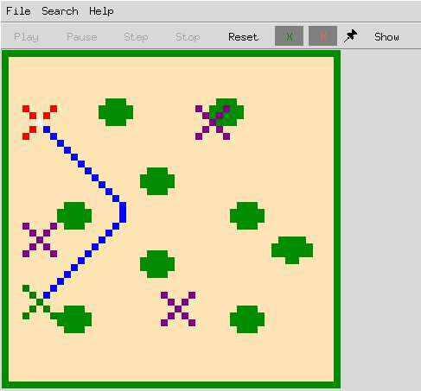
Visualization of Heuristic Model
Methods

Slide 17
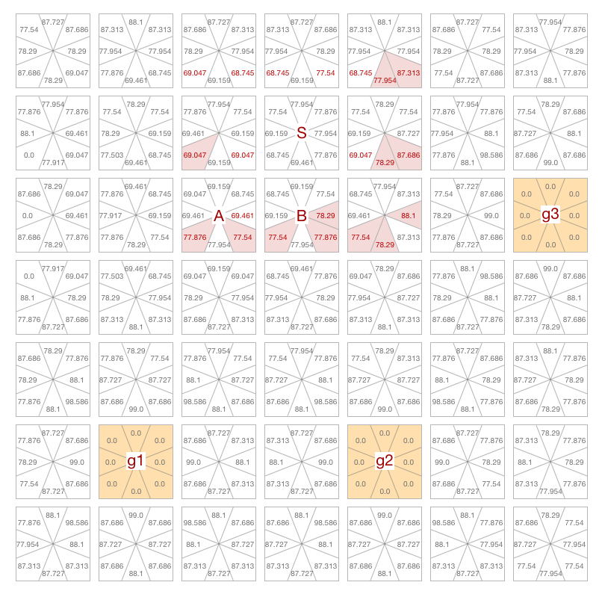
Model 2: Entropy Method
Main Idea
Find the most ambiguous move for the current node by calculating the entropy.
Methods

Slide 18
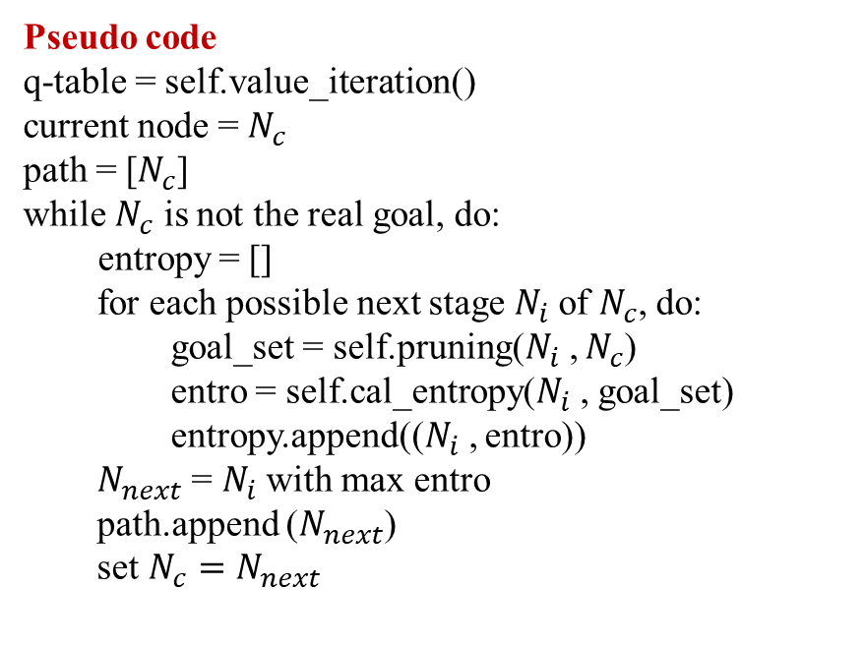
Model 2: Entropy Method
Pseudo code
q-table = self.value_iteration()
current node = $N_{c}$
path = [$N_{c}$]
while $N_{c}$ is not the real goal, do:
entropy = []
for each possible next stage $N_{i}$of $N_{c}$, do:
goal_set = self.pruning($N_{i}$, $N_{c}$)
entro = self.cal_entropy($N_{i}$, goal_set)
entropy.append(($N_{i}$, entro))
$N_{next}$ = $N_{i}$with max entro
path.append ($N_{next}$)
set $N_{c}=N_{next}$
Example
For S to A:
goal_set = (g1, g2)
entro: p1 = 77.876/(77.876+77.54) p2 = 77.54/(77.876+77.54) entro = - (p1*log(p1) + p2*log(p2))
Methods

Slide 19
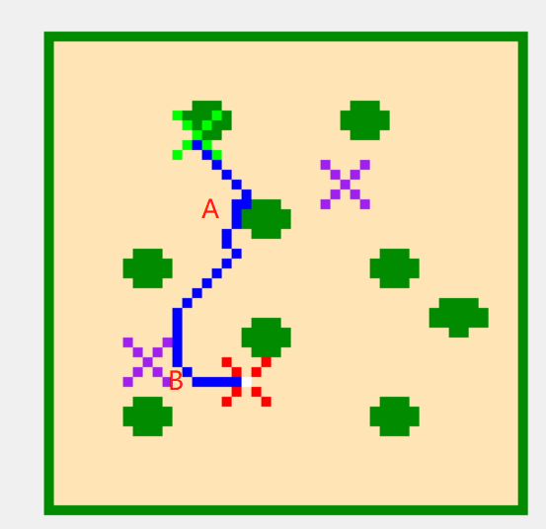
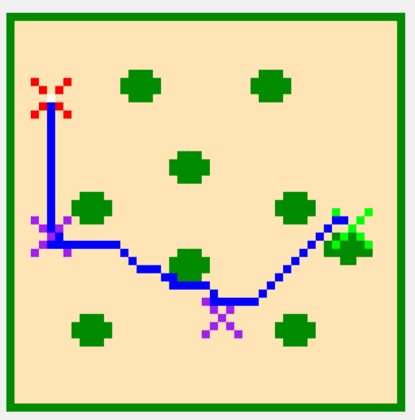
Visualization of Entropy Model
Green: start point, Red: real goal, Purple: fake goals
Methods

Slide 20
Evaluation
4 models: Dummy (Astar) | Entropy | Heuristic | Original Ambiguity
33 experiments = 3 maps * 11 configuration for each model
Metrics
Proportion of exposed paths against density
Probability of the real goal against the density
Cost ratio
Evaluation

Slide 21
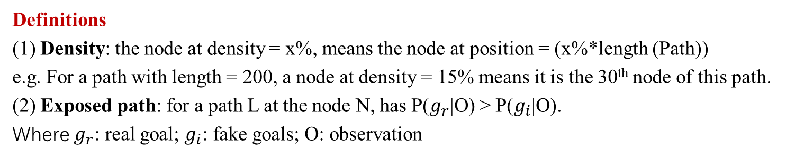
Evaluation 1. Proportion of exposed paths against density
Definitions
(1) Density: the node at density = x%, means the node at position = (x%*length (Path))
e.g. For a path with length = 200, a node at density = 15% means it is the 30th node of this path.
(2) Exposed path: for a path L at the node N, has P($g_{r}$|O) > P($g_{i}$|O).
Where $g_{r}$: real goal; $g_{i}$: fake goals; O: observation
Evaluation

Slide 22
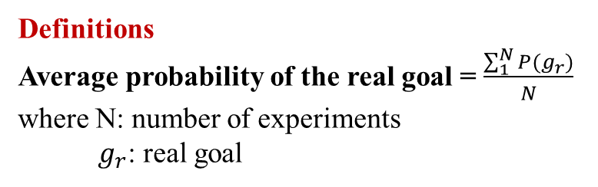
Evaluation 2. Probability of the real goal against the density
Definitions
Average probability of the real goal = $\frac{\sum_{1}^{N}{P(g_{r})}}{N}$
where N: number of experiments
$g_{r}$: real goal
Evaluation

Slide 23
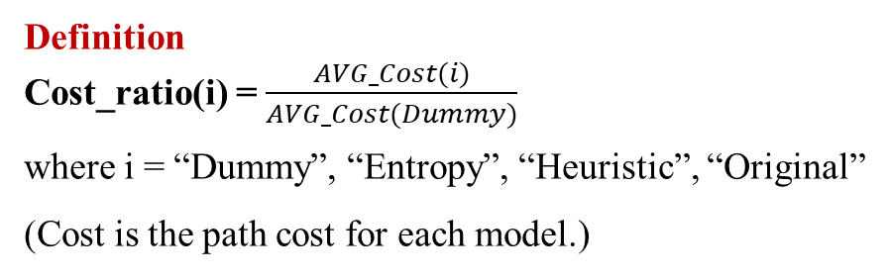
Evaluation 3. Cost ratio
Definition
Cost_ratio(i) = $\frac{AVG_Cost(i)}{AVG_Cost(Dummy)}$
where i = “Dummy”, “Entropy”, “Heuristic”, “Original”
(Cost is the path cost for each model.)
Evaluation

Slide 24
Conclusion
Reinforcement learning in deceptive path-planning
Evaluation summary: Heuristic model and Entropy model (1) Less information leak, less time complexity. (2) Both of the models perform deception in path-planning with different degrees. (3) For Heuristic Model: trade-off between cost and capacity of deception (4) For Entropy Model: similar capacity of deception with similar path cost
Conclusion

Slide 25
Reference
[1] Whaley, B. (1982). Toward a general theory of deception. The Journal of Strategic Studies, 5(1), 178-192.
[2] Masters, P., & Sardina, S. (2017, August). Deceptive Path-Planning. In IJCAI (pp. 4368-4375).
[3] Yue Y. , Zhengshang L. , Peta M. , Tim M. Deceptive Reinforcement Learning for
Preserving the Privacy of Reward Functions. Retrived from: https://piazza.com/class_profile/
get_resource/k440kkcj3o9516/k74k4sal74n4fw
[4] Anderson, D., Stephenson, M., Togelius, J., Salge, C., Levine, J. and Renz, J., 2018, April.
Deceptive games. In International Conference on the Applications of Evolutionary Computation
(pp. 376-391). Springer, Cham.
Conclusion

Slide 26
Thank You !
Notes:
https://unimelb.zoom.us/j/97701220274?pwd=M2FFbHNsY1dxb29CRTZ0cW9QY1ZZZz09
Password: 211860
2 Jun, 10:00-11:10am

